Slide 1
NEOHX Study: Perioperative Treatment With Trastuzumab in Combination With Capecitabine and Oxaliplatin (XELOX-T) in Patients With HER-2 Resectable Stomach or Esophagogastric Junction (EGJ) Adenocarcinoma: 18 Months Disease-Free Survival (DFS) Analysis
Abstract 107
Rivera F, Jimenez P, García Alfonso P, Lopez C, Gallego J, Limón ML, Alsina M, López L, Galán MC, Falcó E, Manzano JL, Gonzalez E, Serrano R, Fernández E, Jorge M

Slide 2

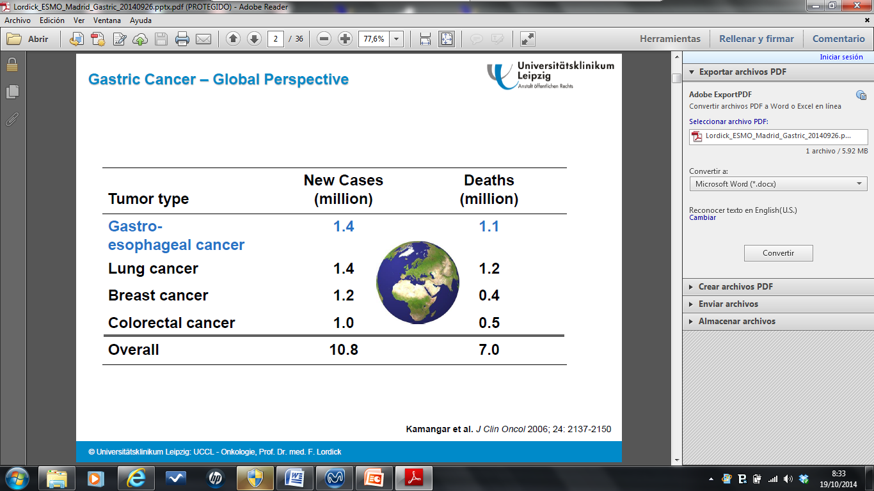
Gastric Cancer: Introduction
Kamangar F, et al. J Clin Oncol. 2006;24(14):2137-2150.
Rivera F, et al. J Clin Oncol. 2015;33(suppl 3): Abstract 107.

Slide 3
Gastric Cancer: Introduction
Gastric cancer
5 year overall
suvival (OS) 25%¹
5 year OS
Stage
Resectable early disease (T1-2, N0, M0) 10% → 5 year OS*: 70%
Resectable locally advanced disease (T3-4, N+, M0) 40% → 5 year OS*: 30%
Unresectable locally advanced disease 20% → Median OS: 13 months
Metastatic (M1; stage IV) 30% → Median OS: 10 months
*with Surgery alone
1. De Angelis R, et al. Lancet Oncol. 2014;15(1):23-34.
Rivera F, et al. J Clin Oncol. 2015;33(suppl 3): Abstract 107.

Slide 4
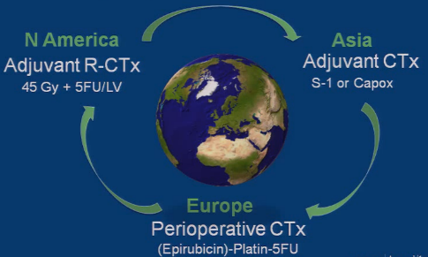
Treatment Options in Resectable EGJ and Gastric Adenocarcinoma
Rivera F, et al. J Clin Oncol. 2015;33(suppl 3): Abstract 107.

Slide 5
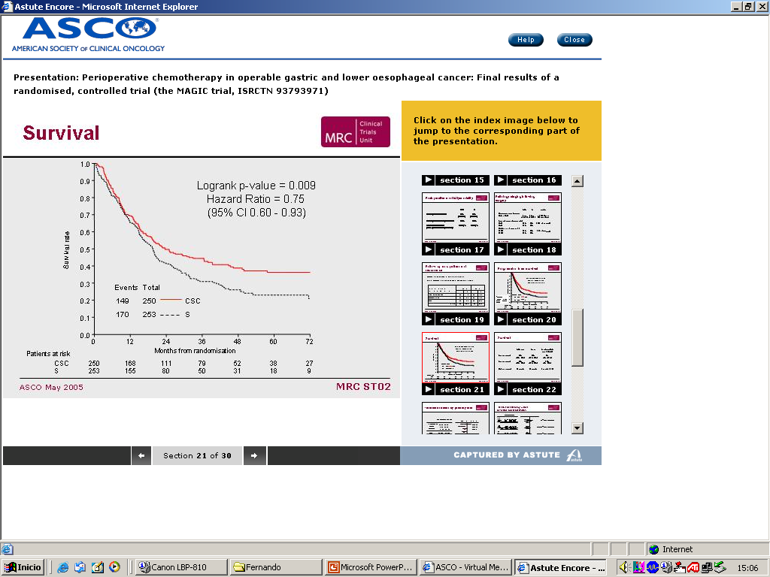
Perioperative Chemotherapy: MAGIC-1
503 Patients (pts)
Resectable Stage II-IV (M0)
Gastric 74%
EGJ 26%
Perioperative chemo
ECF x 3→Surgery→ECF x 3
(44% of patients)
Surgery
Survival
Survival (3 years): 43% P<.05 32%
Loc Rel (3 years): 29% P<.05 44%
Dist Rel (3 years): 31% P<.05 45%
Cunningham D, et al. N Engl J Med. 2006;355(1):11-20.
Rivera F, et al. J Clin Oncol. 2015;33(suppl 3): Abstract 107.

Slide 6
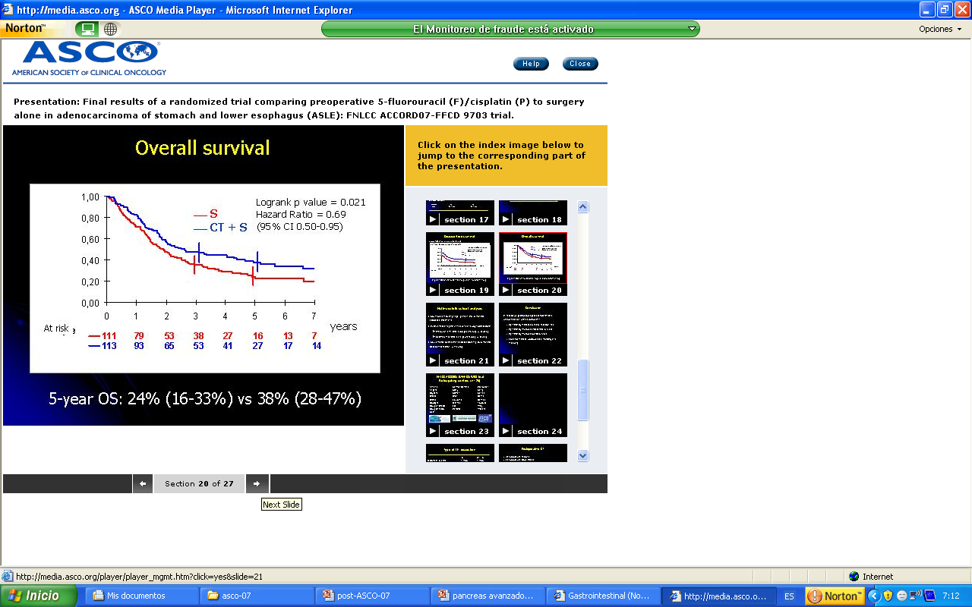
Perioperative Chemotherapy Phase III FNLCC-ACCORD07-FFCD 9703
224 Patients
Resectable adenocarcinoma
Gastric (no EGJ) 25 % EGJ 64 % Distal esophagous 11 %
PS 0 / 1 (75% / 25%)
Perioperative chemo
CFx2-3→Surgery
(→CF x 4 postSx if overall response or stable disease with pN+: 50% patients)
Surgery
Primary endpoint: Survival
 | CF> Survival | Survival | HR | P value
Survival (5 year) | 38% | 24% | 0.66 | .01
DFS (5 year) | 34% | 21% | 0.65 | .003
Boige V, et al, J Clin Oncol. 2007;25(18S): Abstract 4510.
Rivera F, et al. J Clin Oncol. 2015;33(suppl 3): Abstract 107;

Slide 7
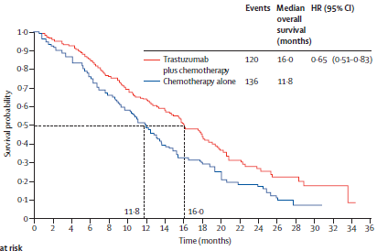
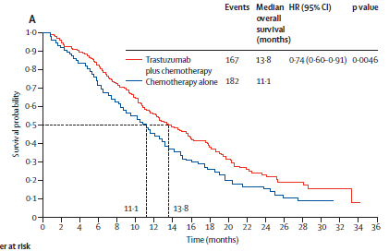
P. III TOGA (C-X/F vs C-X/F-Trastuzumab)
3807 scrined pts →810 HER2+→ 584 pts included
97% M1; 32% EGJ; 10% ECOG 2
CX(87%)-/F(13%)-Trast 8→6mg/kg/3w
CX(87%)/F(13%)
OS in IHC2+/FISH+ or IHC3+
(exploratory analysis)
Primary endpoint OS
Bang YJ, et al. Lancet. 2010;376(9742):687-697.
Rivera F, et al. J Clin Oncol. 2015;33(suppl 3): Abstract 107.

Slide 8
NEOXH: Design
Capecitabine
(1000 mg/m2/bid
D1-14 q12d)
+
Oxaliplatin
(130 mg/m2 d1 q21d)
+
Trastuzumab
(8 mg/kg and then 6 mg/kg d1q21d)
3 cycles
Pts with HER2- positive locally advanced potentially resectable gastric cancer
If R0 or R1:
capecitabine
+
oxaliplatin
+
trastuzumab
3 cycles
Surgery
Trastuzumab 12 cycles
EGJ cancer
N = 36 patients
Objective
The primary endpoint was 18 months DFS, secondary endpoints included pathologic CR, R0 resection rate, the safety profile of XELOX-trastuzumab combination and specifically trastuzumab monotherapy (maintenance treatment), surgical morbidity and mortality
OS and biomarker analysis
Rivera F, et al. J Clin Oncol. 2015;33(suppl 3): Abstract 107.

Slide 9
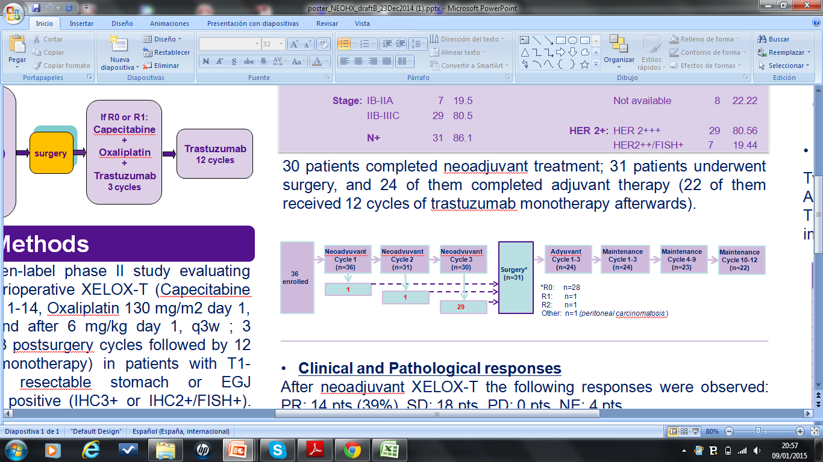
Patient Characteristics
From June 2010 to March 2012, 36 patients
were included in 15 Spanish hospitals
Baseline Charecteristics (n=36
 | N | %
Tumor location
Stomach | 21 | 58.33
EGJ | 15 | 41.66
Stage
IB-IIA | 7 | 19.5
IIB-IIIC | 29 | 80.5
N+ | 31 | 86.1
Type of adenocarcimona
Intestinal | 23 | 63.89
Mixed | 1 | 2.78
Diffuse | 4 | 11.11
Not available | 8 | 22.22
HER2+
HER2+++ | 29 | 80.56
HER2+++/FISH+ | 7 | 19.44
Baseline Charecteristics (n=36)
Age, y | 63.44 | (±1.74)
ECOG | n | %
0 | 16 | 44.4
1 | 19 | 52.78
2 | 1 | 2.78
Gender
Male | 29 | 81
Female | 7 | 19
78 %
Rivera F, et al. J Clin Oncol. 2015;33(suppl 3): Abstract 107.

Slide 10
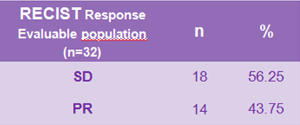
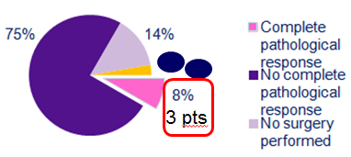
NEOXH: Response
Clinical response
Pathological response (n = 36)
Rivera F, et al. J Clin Oncol. 2015;33(suppl 3): Abstract 107.

Slide 11
NEOXH: PFS and OS
Progression-free survival
Overall survival
1.00
+ Censored
Survival
+ Censored
Survival
Subjects
36
Event
36.1% (13)
Censored
63.9% (23)
Median (CI 95%)
NA (21.9, NA)
1.00
Subjects
36
Event
22.2% (8)
Censored
77.8% (28)
Median (CI 95%)
NA (NA, NA)
0.75
0.75
DFS Probability
SG Probability
0.50
18 months PFS: 71 %
0.50
24 m OS 75 %
24 months PFS: 60 %
0.25
0.25
Patient at risk
Patient at risk
36
26
24
22
13
1
0
36
26
24
22
14
1
0
0.0
0.0
0
6
12
18
24
30
36
0
6
12
18
24
30
36
Time Since Inclusion, months
Time Since Inclusion, months
Rivera F, et al. J Clin Oncol. 2015;33(suppl 3): Abstract 107.

Slide 12
NEOXH: Toxicity
Grade | 1 |  | 2 |  | 3 |  | 4 |  | Total
 | n | % | n | % | n | % | n | % | %
Diarrhea | 10 | 27.78 | 7 | 19.44 | 9 | 25.00 | 3 | 8.33 | 80.56
Asthenia | 15 | 41.67 | 7 | 19.44 | 0 | 0 | 2 | 5.56 | 66.67
Nausea | 11 | 30.56 | 3 | 8.33 | 3 | 8.33 | 0 | 0 | 47.22
Loss of appetite | 9 | 25.00 | 4 | 11.11 | 1 | 2.78 | 1 | 2.78 | 41.67
Vomiting | 6 | 16.67 | 6 | 16.67 | 3 | 8.33 | 0 | 0 | 41.67
Anemia | 5 | 13.89 | 4 | 11.11 | 2 | 5.56 | 0 | 0 | 30.56
Pyrexia | 8 | 22.22 | 1 | 2.78 | 1 | 2.78 | 1 | 2.78 | 30.56
Neurotoxicity | 9 | 25.00 | 1 | 2.78 | 0 | 0 | 0 | 0 | 27.78
Abdominal pain | 7 | 19.44 | 2 | 5.56 | 0 | 0 | 0 | 0 | 25.00
Mucosal inflammation | 5 | 13.89 | 3 | 8.33 | 1 | 2.78 | 0 | 0 | 25.00
Rivera F, et al. J Clin Oncol. 2015;33(suppl 3): Abstract 107.

Slide 13
NEOHX vs MAGIC: Efficacy
Phase II NEOHX (Spain)
36 Patients
Resectable HER2+, gastric-EGJ Cancer Primary endpoint: 18 m DFS
Perioperative xelox-trastuzumab
Xelox-T x3→Surgury→Xelox-T x3→Tx12
R0: 78% (MAGIC: 69%)
pCR: 8% (MAGIC: 0%)
24 m PFS: 60% (MAGIC: 45%)
24 m OS: 75% (MAGIC: 50%)
Rivera F, et al. J Clin Oncol. 2015;33(suppl 3): Abstract 107.

Slide 14


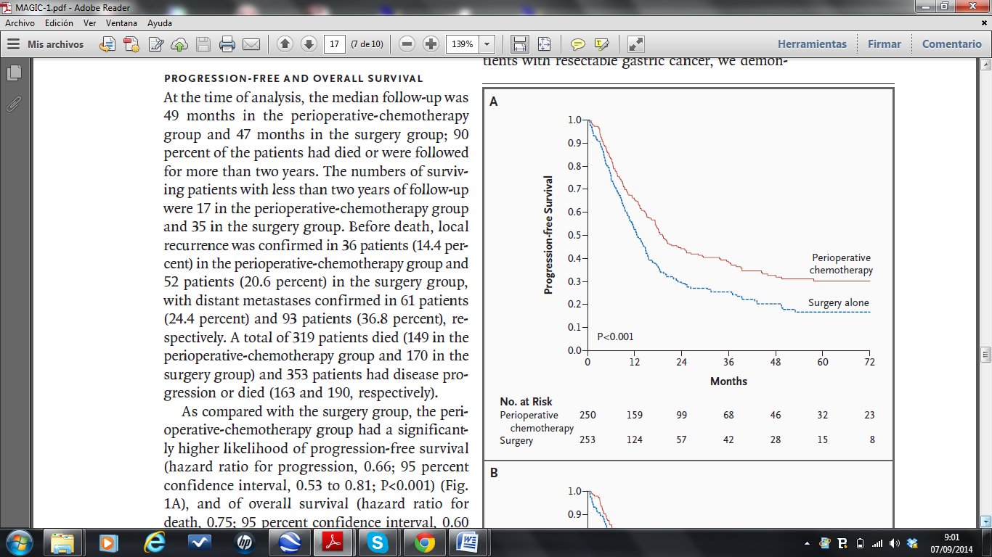
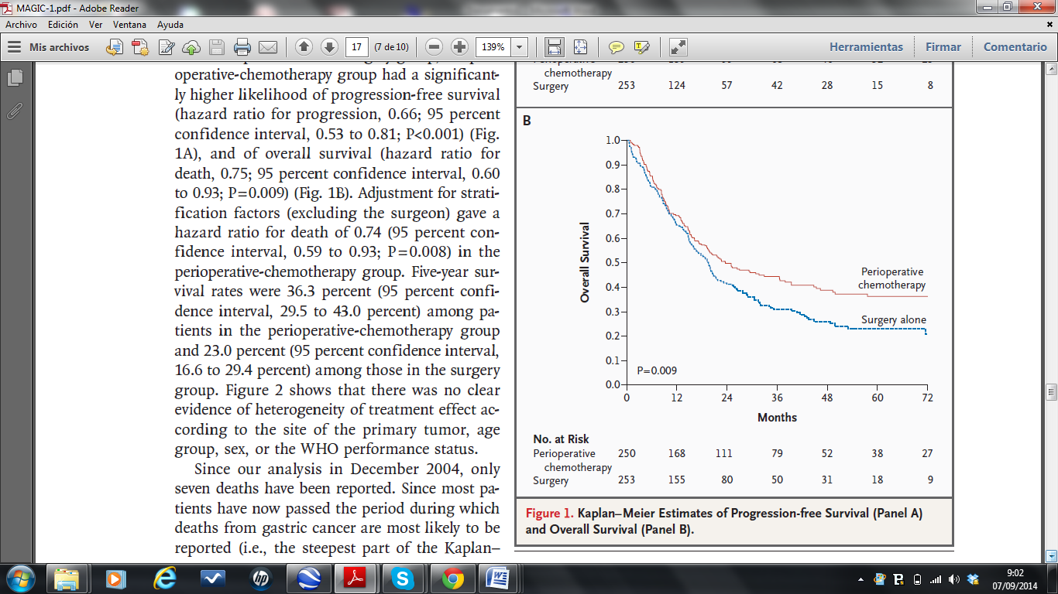
NEOHX vs MAGIC: PFS and OS
24 months PFS
24 months OS
NEOHX
60%
NEOHX
75%
MAGIC chemo
45%
MAGIC chemo
50%
Rivera F, et al. J Clin Oncol. 2015;33(suppl 3): Abstract 107.

Slide 15
NEOXH: Conclusion
NEOHX trial meets its primary endpoint, DFS at 18 months reaches the optimal cutoff (70%)
Perioperative XELOX-trastuzmab in HER2-positive resectable stomach and esophagogastric junction adenocarcinoma is feasible and has a promising activity, showing:
R0: 78%
pCR 8%
18 m PFS; 71%; 24 m PFS: 60%
24 m OS: 75%
Rivera F, et al. J Clin Oncol. 2015;33(suppl 3): Abstract 107.

Slide 16
Studies With Trastuzumab in Resectable HER2+ Esophago-Gastric Adenocarcinoma
Phase II NEOHX (Spain)
36 Pts
Resectable Her 2+, Gastric-EGJ Cancer Primary endpoint: 18 m DFS
Perioperative xelox-trastuzumab
Xelox-T x3→Surgery→Xelox-T x3→Tx12
R0: 78% (MAGIC: 69%)
pCR: 8% (MAGIC: 0%)
24 m PFS: 60% (MAGIC: 45%)
24 m OS: 75% (MAGIC: 50%)
Phase II AIO-STO 0310 (Germany)
53 Pts
Resectable HER2+, Gastric-EGJ cancer primary endpoint: pCR
Perioperative FLOT-trastuzumab
FLOT-T x4→Surgery→FLOT-T x4→Tx9
(Hofheinz R, et al.) R0: 93%; pCR: 22%
Hofheinz R, et al. J Clin Oncol. 2014;32(5S): Abstract 4073.
Rivera F, et al. J Clin Oncol. 2015;33(suppl 3): Abstract 107

Slide 17
Studies With Trastuzumab in Resectable HER2+ Esophago-Gastric Adenocarcinoma
Preoperative carb Tax-RT
Carb Tax/RT 50Gy→Surgery
Phase III RTOG 1010 (USA)
160 Pts
Resectable HER2+ esoph-EGJ adenocarcinoma primary endpoint: DFS
Preoperative CarbTax RT+Periop.Trastuzumab
T-carbTax/RT 50Gy→Surgery→Tx13
Rivera F, et al. J Clin Oncol. 2015;33(suppl 3): Abstract 107.

Slide 18
Anti-HER2 Treatment Neodjuvant Setting? INNOVATION Study – Europe + Korea
STAGE 1:
Randomized phase II “pick the winner” of two experimental arms 1:2:2 randomization
STAGE 2:
Randomized phase III with the best experimental arm of STAGE 1 1:3 randomization
Chemo only
Chemo only
Chemo +
trastuzumab
Chemotherapy + trastuzmab
(+ pertuzumab)
R
IMAGE substudy in selected centers!
What is the accuracy of PDG_PET in targeted (antibody) treatment
Chemo +
trastuzumab +
pertuzumab
Rivera F, et al. J Clin Oncol. 2015;33(suppl 3): Abstract 107.

